Slide 1
Determining Influential Factors of Student Success in K-12 Schools
Edward Broeder

Slide 2
Data Set
2012-2013 Academic Year data from California K-12 charter and public schools, on the following topics
  Academic Performance
  Student/Staff Demographics
  Parent/Teacher Education Levels
  General School Information (location,
Original plan: Use greatschools.org API to query for various datapoints on CA schools
  Issue: unable to get API key in time
New and improved plan: Download multiple datasets from CA government data portals, and correlate the various datapoints to build one large dataset to analyze.

Slide 3
Data Sources
http://www3.cde.ca.gov/starresearchfiles/2013/p3/ca2013_1_csv_v3.zip 344063 records - CA STAR testing results
  https://star.cde.ca.gov/star2013/ResearchFileList.aspx?ps=true&lstTestYear=2013&lstTestType=C&lstCounty=43&lstDistrict=&lstSchool=&lstGroup=1&lstSubGroup=1&lstCntyNam=Santa%20Clara&lstDistNam=(none%20selected)
ftp://ftp.cde.ca.gov/demo/cbeds/cbedsora12a.txt 45157 records (converted to csv) - staff demographics
https://dq.cde.ca.gov/dataquest/content.asp 127113 records - enrollment demographics
https://www.cde.ca.gov/ds/si/ds/pubschls.asp 17997 records - public school information
http://www3.cde.ca.gov/researchfiles/api/api13gtx.zip 10946 records - Academic Performance Index (API)
  https://www.cde.ca.gov/ta/ac/ap/apidatafiles.asp
Total Records: 545,276, over 200 fields

Slide 4
Hypothesis
Increased parent education levels would correlate with a higher student performance index
Increased percentage of emergency-credential holding teachers would correlate with a lower student performance index
Student performance would be greater in highly-populated regions compared to rural regions

Slide 5
Tools, Algorithms, Difficulties
Tools used:
  Perl – Practical Extraction and Reporting Language
  gnuplot – An interactive plotting program
Difficulties:
  Bad data: Missing values or unexpected format of data (required data filtering and validations using regular expressions)
  Analysis method: It can be hard to figure out exactly which datapoints to compare, and how to visualize the data
Benefits:
  Simplicity: As per Professor Chen’s suggestion early in the semester, use only what is necessary for the task
  Availability: Perl and gnuplot are likely already installed on your Linux machine

Slide 6
Tools, Algorithms, Difficulties cont.
Implementation:
  Data is read into memory (a Perl hash) from 5 text files, totaling ~550K lines
  A data cache is kept in the working directory (to speed up future runs) in the form of a Perl Storable
  The program has functionality to print a full dump of the combined data
  The primary function is to plot user-specified data fields in user-specified formats
  Data is filtered and validated using regular expressions, to help ensure integrity and remove bad values
  The tool is built in a modular fashion, so new fields and data sources can be easily added

Slide 7
API
But not the API you’re thinking of…
Academic Performance Index : The API is a single number, ranging from a low of 200 to a high of 1000, which reflects a school’s or a student group’s performance level, based on the results of statewide assessments.
  Source: https://www.cde.ca.gov/ta/ac/ap/documents/apiexecsummary.pdf
API scores were compared against various datapoints to attempt to discern any factors that may influence student academic performance.

Slide 8
Results

Slide 9
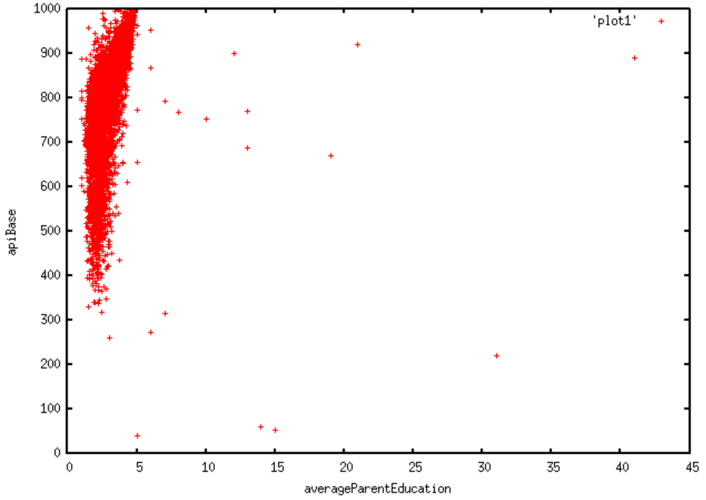
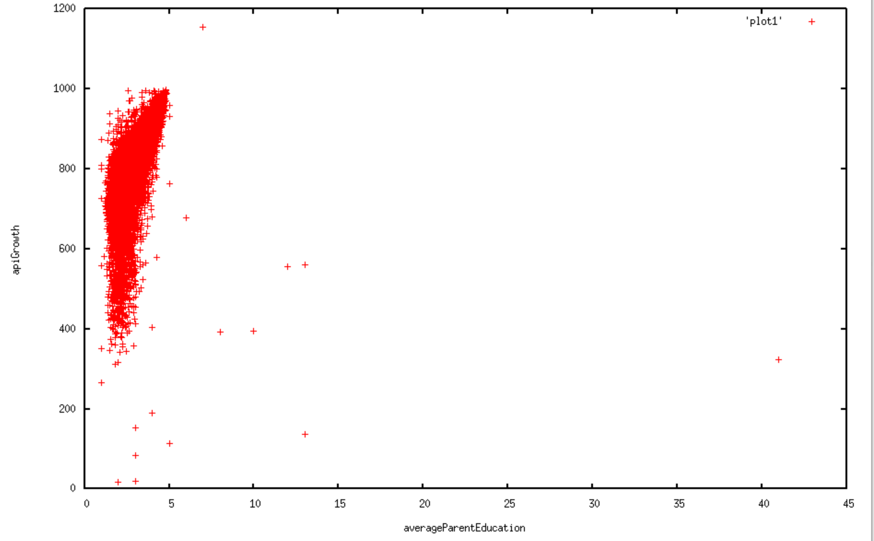
API vs. Average Parent Education (years)
Findings: Positive correlation between average parent education and student performance

Slide 10
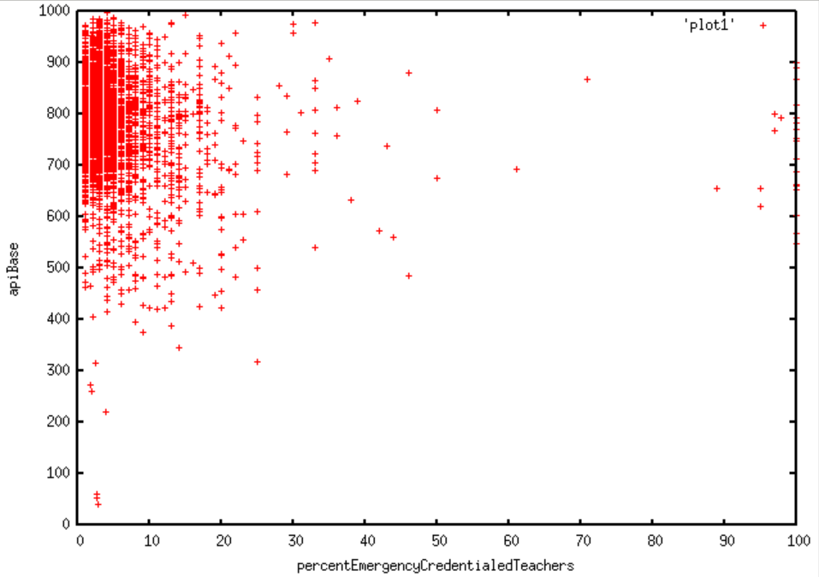
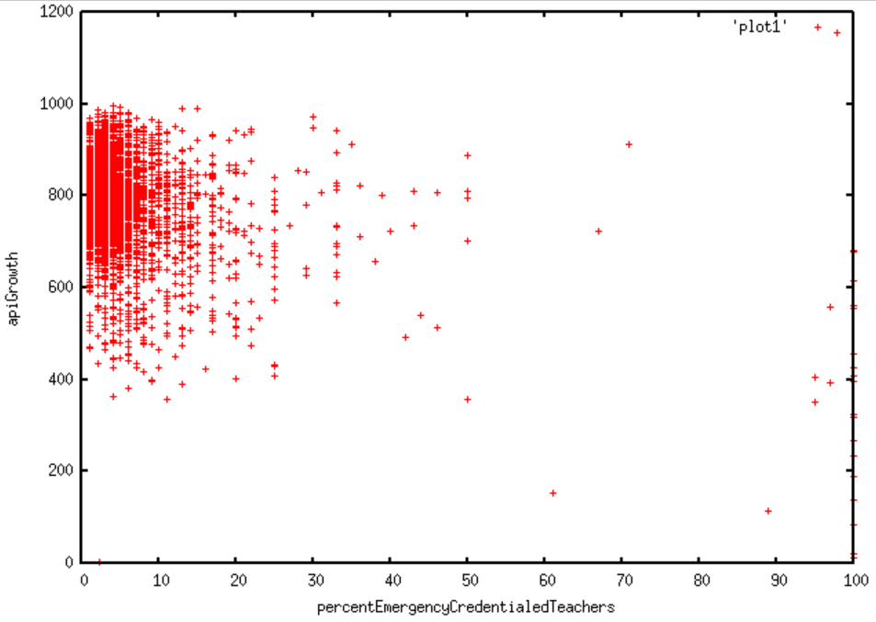
API vs. Percent of Emergency Credentialed Teachers
Findings: No apparent correlation between percent of emergency credentialed teachers and student performance

Slide 11
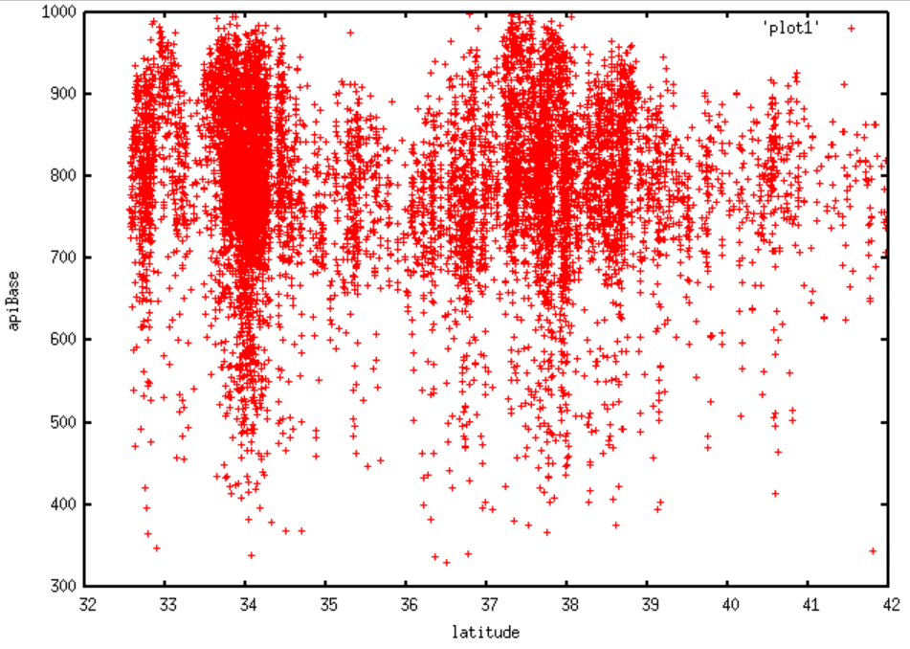
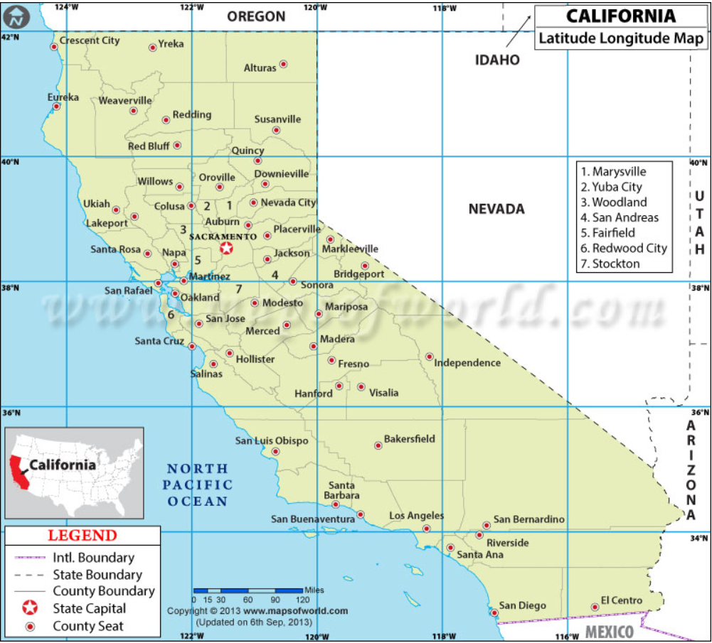
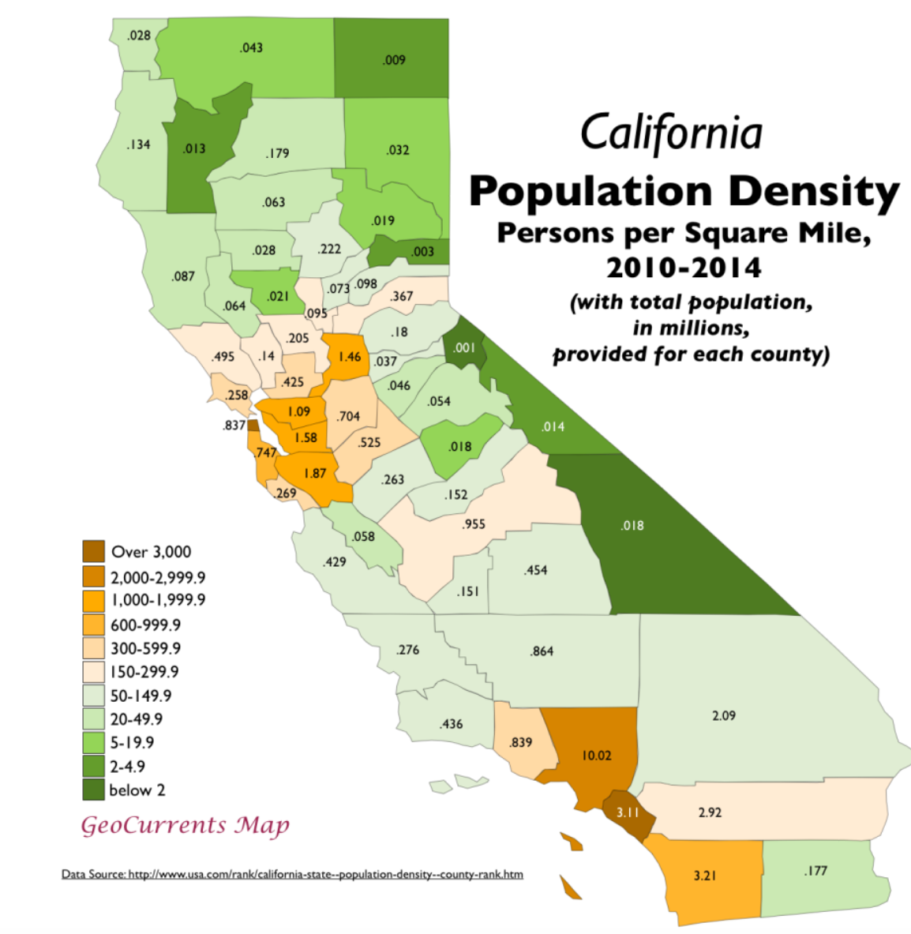
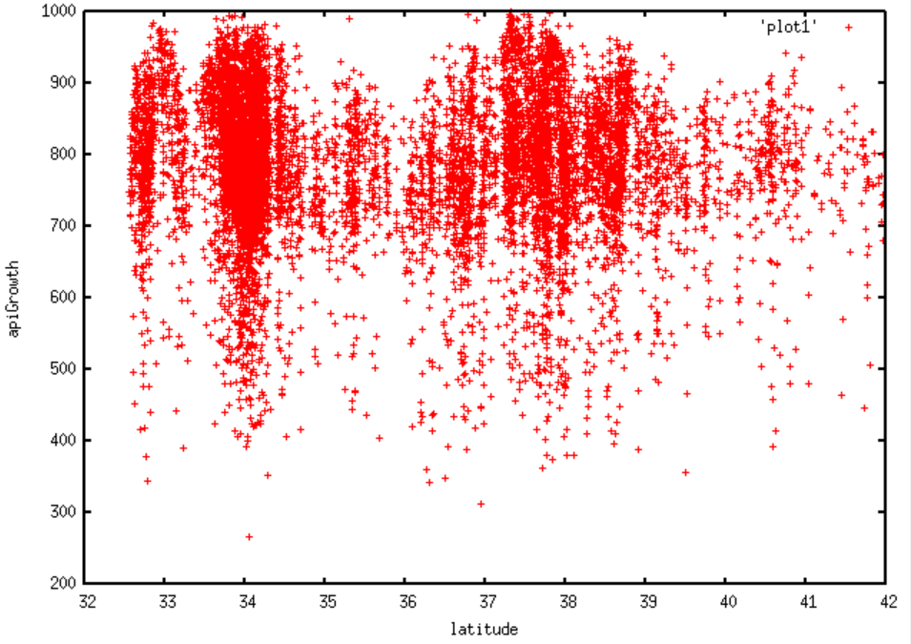
API vs. Geographical Latitude
Source: https://www.mapsofworld.com/usa/states/california/lat-long.html
Source: http://www.geocurrents.info
Findings: There appears to be a positive correlation between certain (33, 34, 37-38) latitudes and student performance. This may be related to the higher population density in the bay area (37-38) and LA area (34). It also may be related to increased property taxes in more expensive areas, as property taxes are often used to fund schools

Slide 12
Hypothesis – Tested
Increased parent education levels would correlate with a higher student performance index TRUE
Increased percentage of emergency-credential holding teachers would correlate with a lower student performance index FALSE
Student performance would be greater in highly-populated regions compared to rural regions TRUE

Slide 13
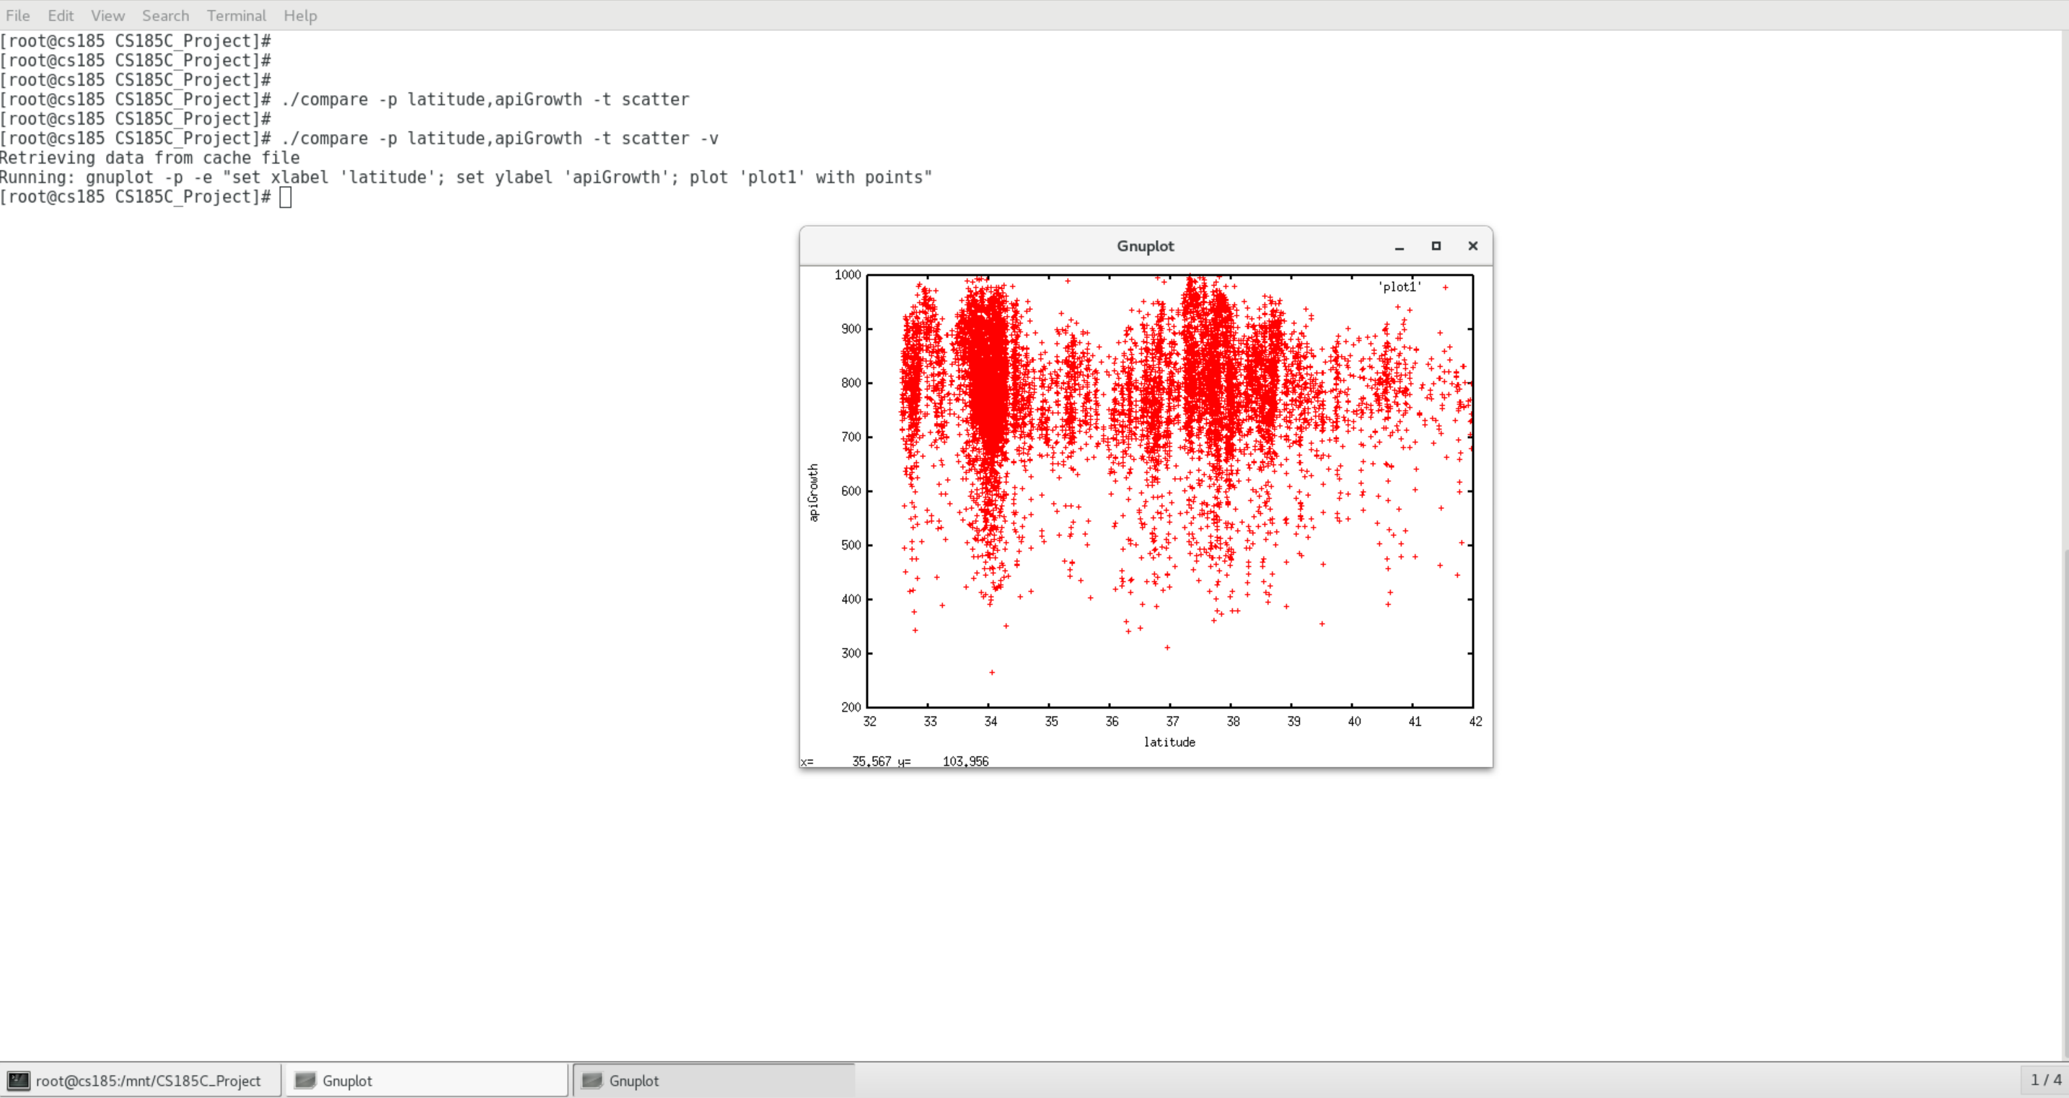

Slide 14
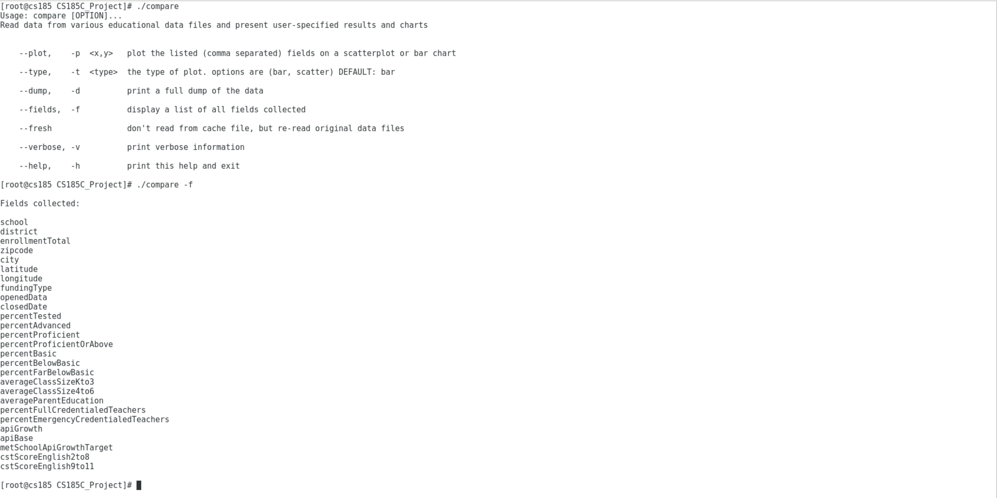
Example Usage:

Slide 15
The End

